Slide 1

The ultimate go-to-market strategy

Slide 2
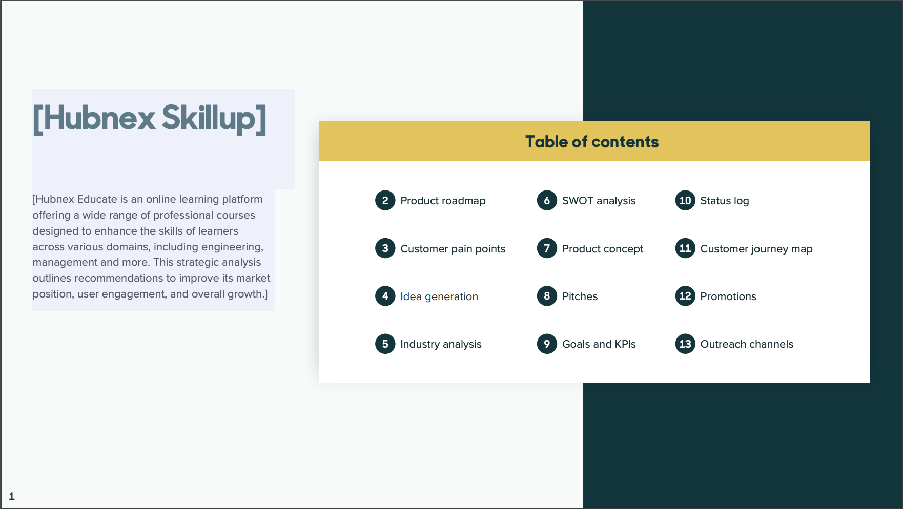

Slide 3
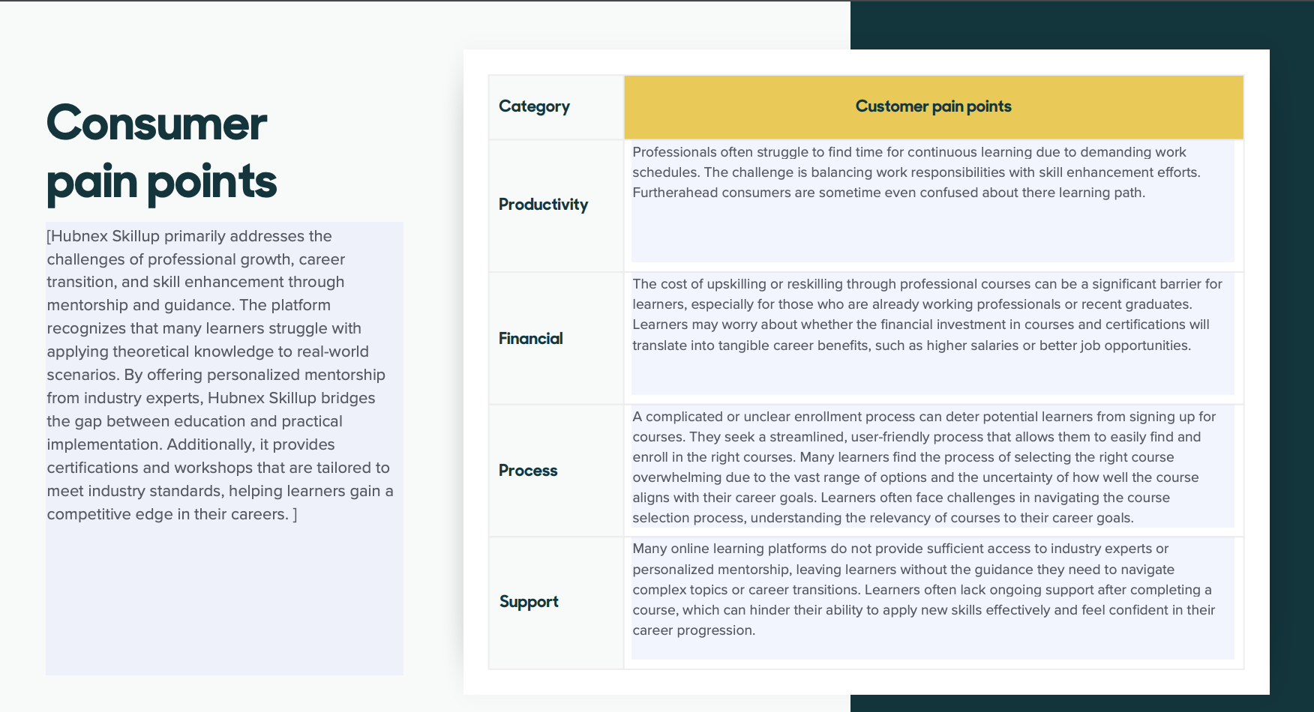

Slide 4
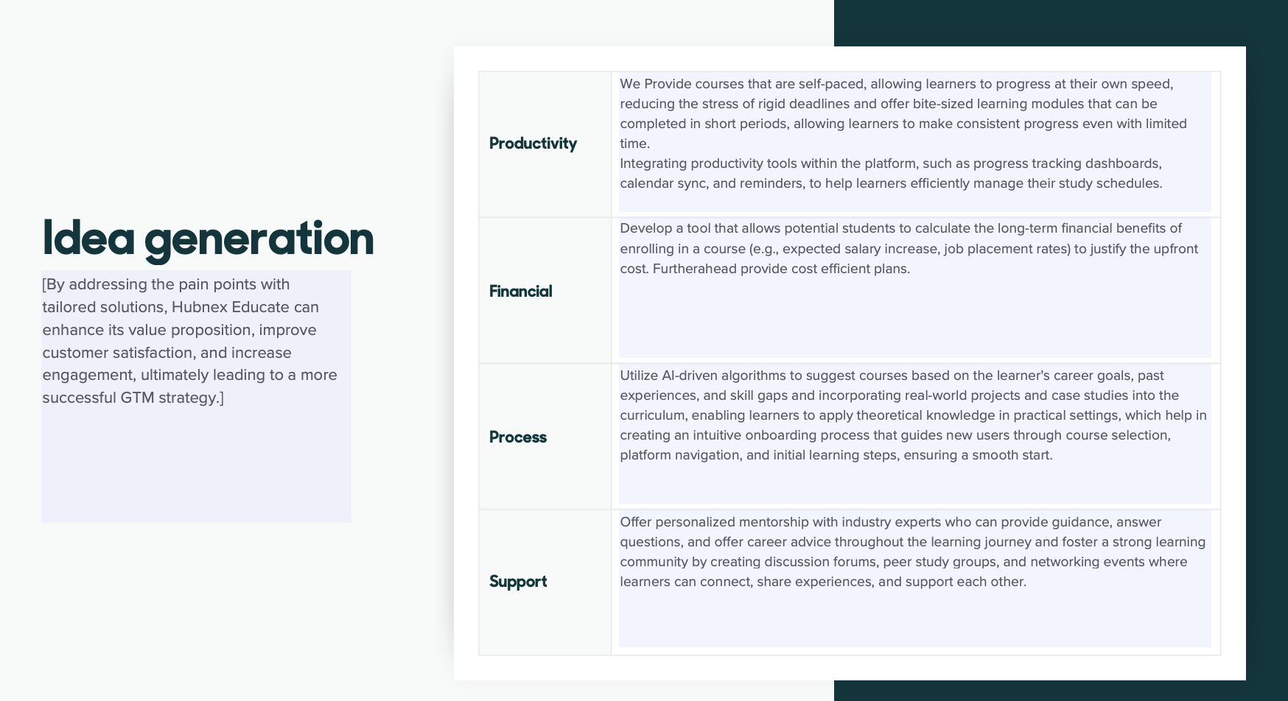

Slide 5
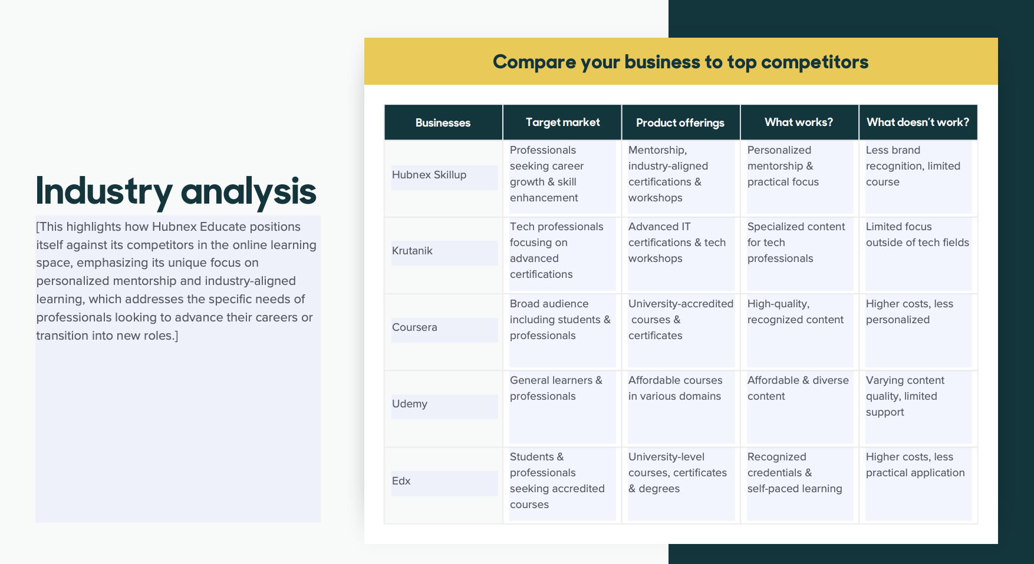

Slide 6
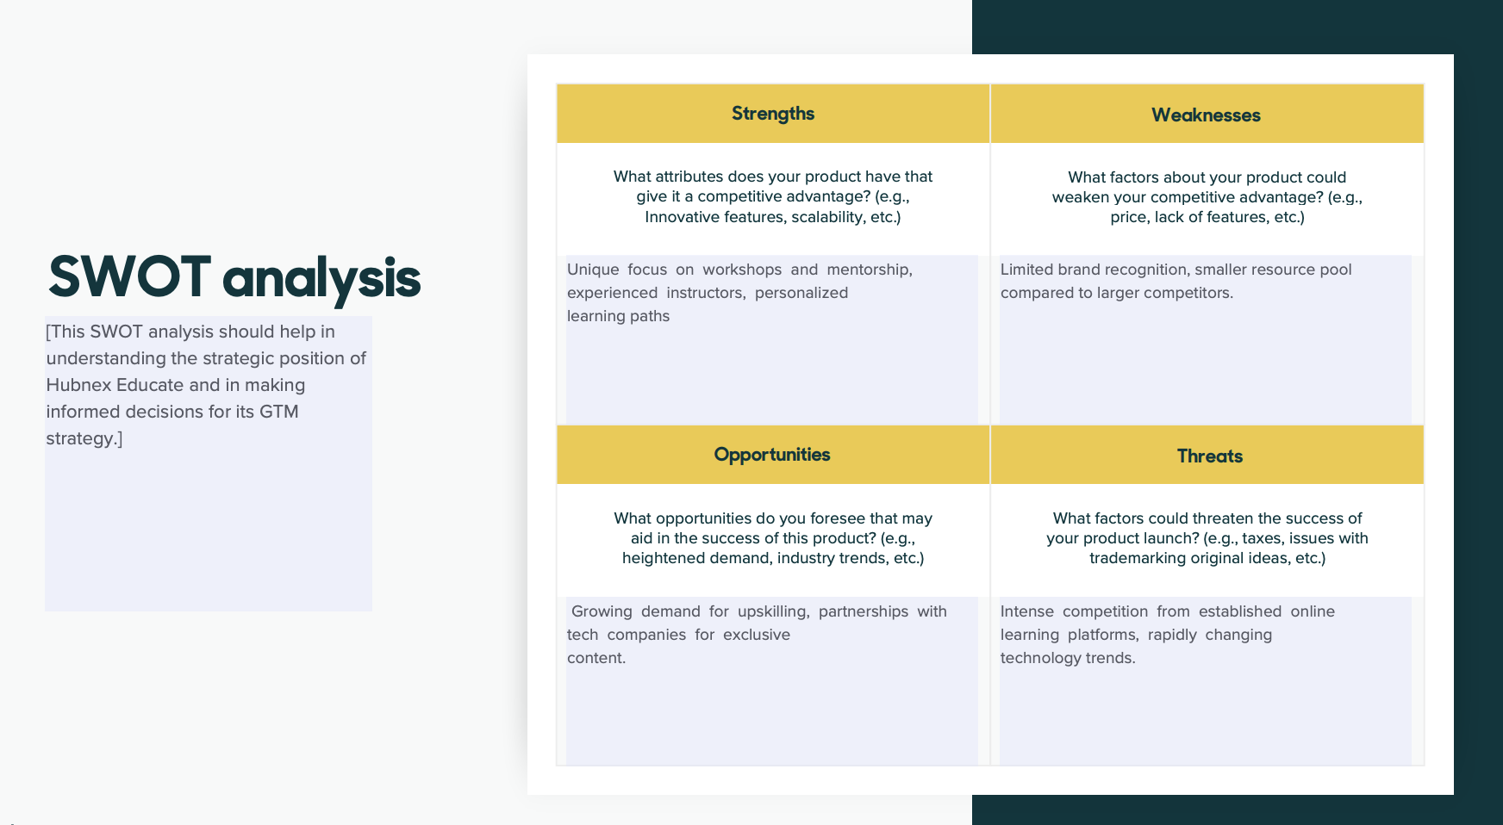
STRENGTHS
WEAKNESSES
OPPORTUNITIES
THREATS

Slide 7
Product Concept
S. No. | Pain Points | Solution | Competitor Notes | Important Features | Unique Selling Proposition (USP)
1 | Difficulty in applying theoretical knowledge to real-world problems. | Personalized mentorship from industry experts bridging theory and practice. | Competitors like Coursera, Udemy etc. focus on offering a wide range of online courses but lack in personalized mentorship and real-world application. | One-on-one mentorship from industry experts. | Direct, personalized mentorship from industry veterans.
2 | Limited access to personalized mentorship. | Workshops tailored to industry standards and Certifications that improve career prospects. | Bootcamps (e.g., General Assembly) provide intense short-term training but may lack flexibility and mentorship depth. | Certifications that meet current industry demands. Hands-on sessions focused on real-world application. | Focus on real-world skill application. Certifications that directly improve employability and industry relevance.
3 | Confusion in navigating career transitions and skill upgrades. | Structured guidance for career transition and growth |  | Tailored guidance for career change or skill enhancement. | Specialized programs for professionals looking to shift careers or upgrade skills.

Slide 8
Pitches
To Leadership: Emphasize the growing demand for upskilling and the unique positioning of Hubnex Educate.
To Donors and Finance: Highlight the potential for revenue generation and the need for initial funding to develop high-quality content.
To Target Audience: Showcase the benefits of practical learning and personalized mentorship in achieving career goals.

Slide 9
Goals and KPIs
Goals | KPIs
Goal 1: Achieve a 20% increase in workshop participants within the first six months. | Number of sign-ups and participants
Goal 2: Establish partnerships with at least three tech companies for exclusive content. | Number of partnerships and collaborations
Goal 3: Attain a 90% satisfaction rate among participants | Participant feedback and reviews

Slide 10
Customer Journey Map
Awareness: Social media campaigns, online ads, and content marketing.
Consideration: Free webinars, trial workshops, and testimonials from past participants.
Purchase: Easy sign-up process, secure payment options, and immediate access to resources.
Retention: Continuous support, follow-up mentorship sessions, and community engagement.
Advocacy: Encourage referrals and offer incentives for recommendations

Slide 11
Promotions and Outreach Channels
Online Marketing: Social media, email campaigns, SEO optimization, and content marketing.
Offline Marketing: Collaborations with educational institutions, tech meetups, and industry conferences.
Customer Service: Dedicated support team to assist participants with any issues or inquiries

